Slide 1

Project Seminar on Web Based Monitoring And Maintaining An Organization
Presented By
Kalash Ahir
Guided By
Mr. Ratnesh K. Choudhary
Department of Computer Science & Engineering
S. B. JAIN INSTITUTE OF TECHNOLOGY MANAGEMENT AND RESEARCH,NAGPUR
An Autonomous Institute, Affiliated to RTMNU, Nagpur
S. B. Jain Institute of Technology Management and Research

Slide 2
Contents
Problem Statement & Objectives
Introduction
Literature Survey
System Design
Use Case Diagram
Developed Modules
Modules Description
Modules Screenshots
Technology Used
Hardware Details
Advantages & Applications
Conclusion
Future scope
S. B. Jain Institute of Technology Management and Research
2

Slide 3
Problem Statement & Objectives
Problem Statement :
Nowadays there are many NGOs that are engaged to act for different countries. However, it is obvious that a person can’t know them all and what things they do or in what countries they operate, and would be impossible to go looking for names and contact information one by one
In addition many of these organizations do not provide all the information that people expect to see: what they do, how they spend the money, in which countries they act .
Objectives
To Provide Advance Search facility to user and providing all information related to NGO like how they work.
To Reduce affords of user.
To Provide full satisfaction to user.
If someone is willing to volunteer the charity, they can join us.
S. B. Jain Institute of Technology Management and research
3

Slide 4
Introduction
The growing significance of website for various organization is well known
Our idea is to give support to NGOs to be able to manage their information by themselves and become better known. Report in which countries they operate, what they do, where or how they invest the money, how to collaborate with them ... these are key elements in generating trust in society, and what a better way than centralizing all information in one place in order to be displayed in an interactive and user-friendly.
We know that people are interested in collaborating and contributing their bit, so with our project what we want is to give people a space where they can find information about different NGOs, see where they work and how they work interactively, locate different types of disasters that take place in the world and provide the means to help in one way or another.
S. B. Jain Institute of Technology Management and research
4

Slide 5
Literature Survey
Websites / Paper / Article | Reviews / Findings
1. Crowdfunding | In this design , they have given information related to funding ,how the system works and for what cause they are raising funds. A form is provided to fill up the details to raise funds.
2.Indiantownseva | In this design their main agenda was to reach the oxygen concentrator to the rural areas.They have provided their collaboration details and shown the idea of what problems they are facing.
S. B. Jain Institute of Technology Management and research
5

Slide 6
System Design: Flowchart
User
Home
Contact
Location
Sections
Campus
Facilities
Testimonials
1st Section
Registration Form
Education
2nd Section
Health Care
3rd Section
S. B. Jain Institute of Technology Management and research
6

Slide 7
Use Case Diagram
Web Based Monitoring And Maintaining Organization
User Admin
User or Admin
Home page
Data Collection
Registration Form
View Submission

Slide 8
Modules Description
Creating Web Based Monitoring and Maintaining an organization
Admin Module :
In this Module we first land up on home page, where we get to know about the NGO like which sections are included i.e which age group people are their. Then we see in which other cities this charity is operating and what are the facilities provided like basic education, health care etc. Then we have shown block of testimonials, where we have provided some experiences of volunteers
Then on next page i.e contact page we have provided all the contact details of ngo in case they are willing to join the charity along with a registration form.

Slide 9
Modules Description
2. User Module:
In this module user will directly land up on home where they will get all the
information related to organization. Then they will get an option to visit on another page i.e contact page. In that page they can visit the location provided
and can fill the registration form to join the charity as a volunteer and submit the form

Slide 10
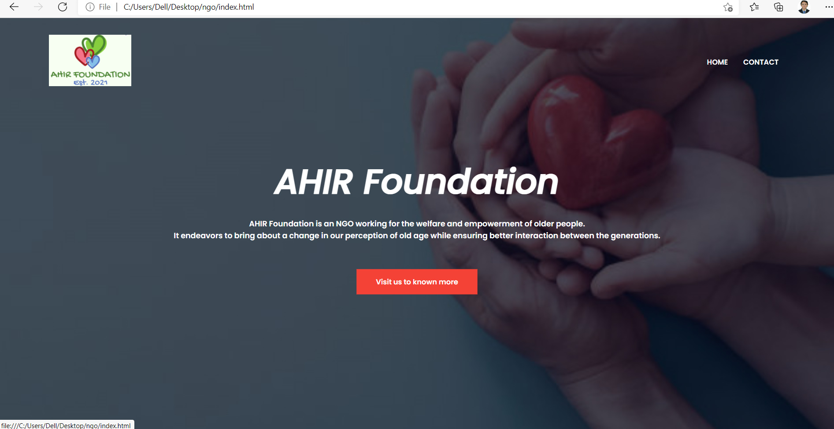
Screen Shots
S. B. Jain Institute of Technology Management and research
10

Slide 11
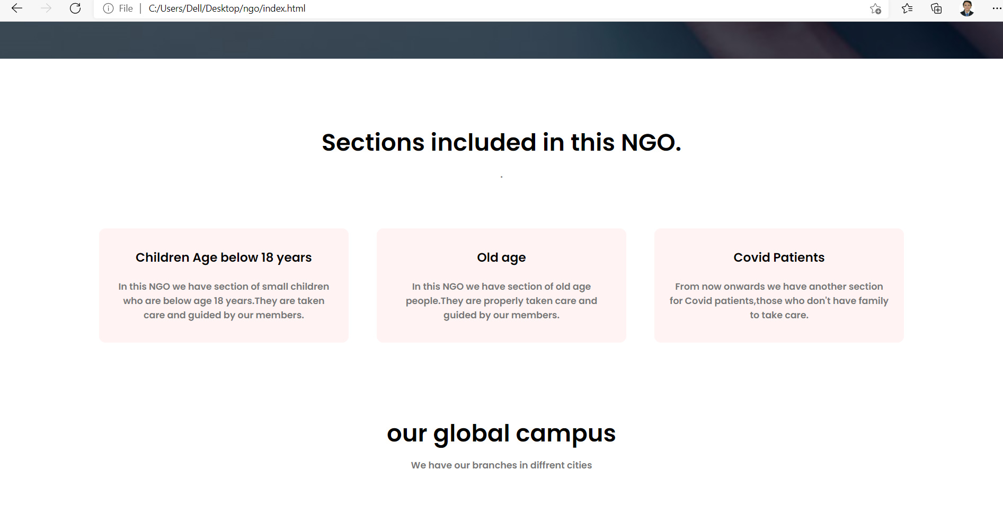
Screen Shots

Slide 12
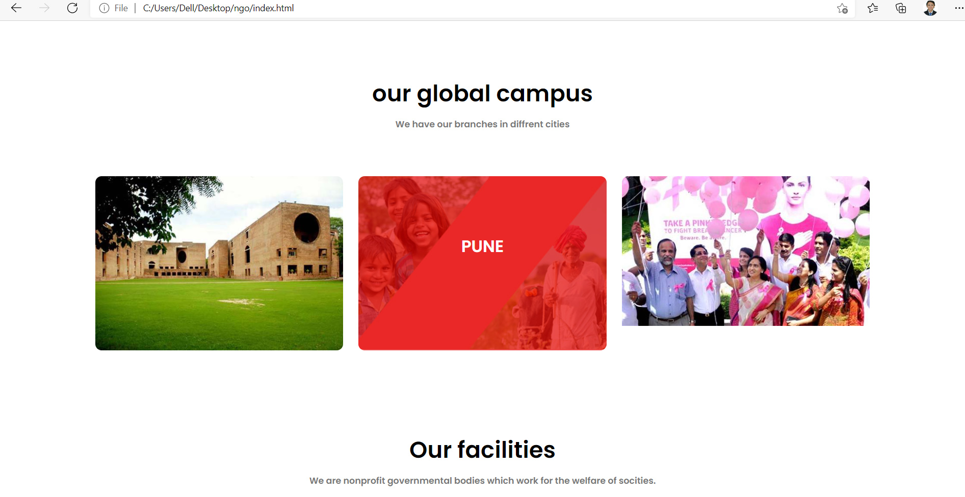
Screen Shots

Slide 13
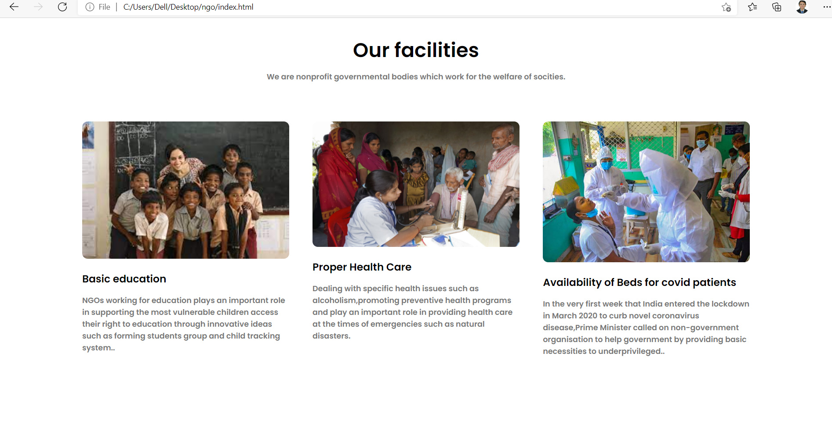
Screen Shots

Slide 14
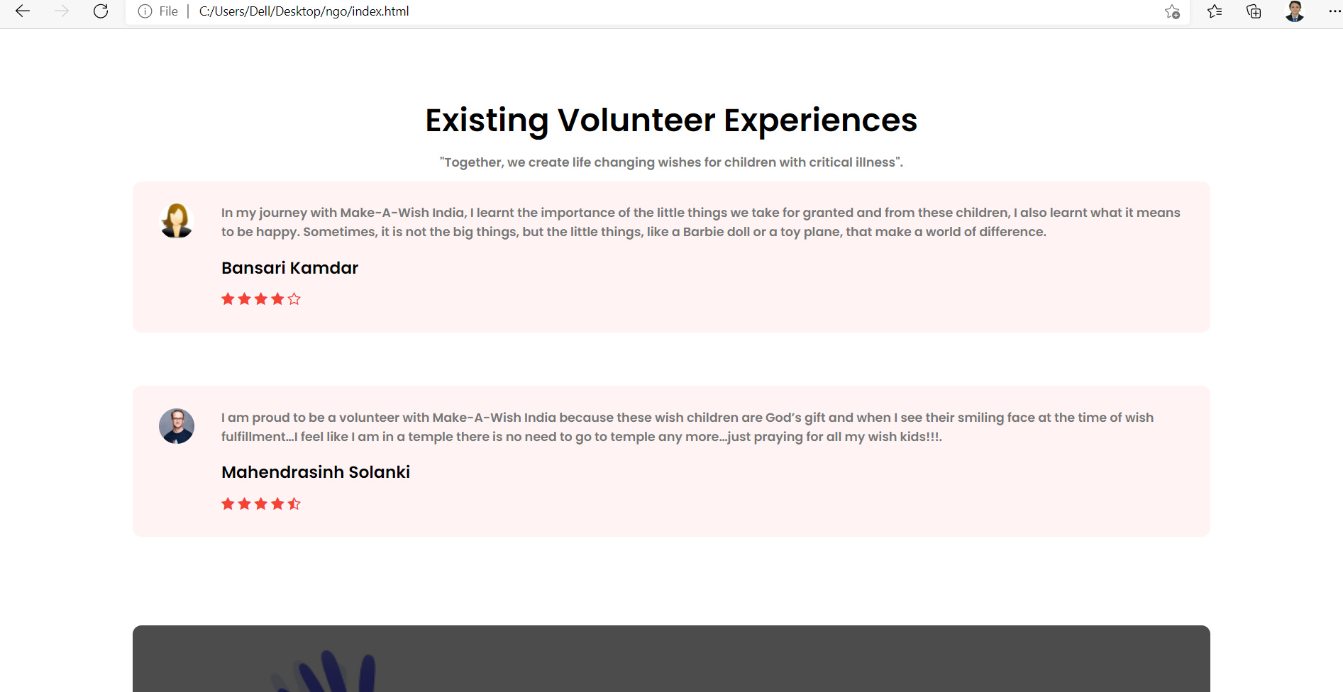
Screen Shots

Slide 15
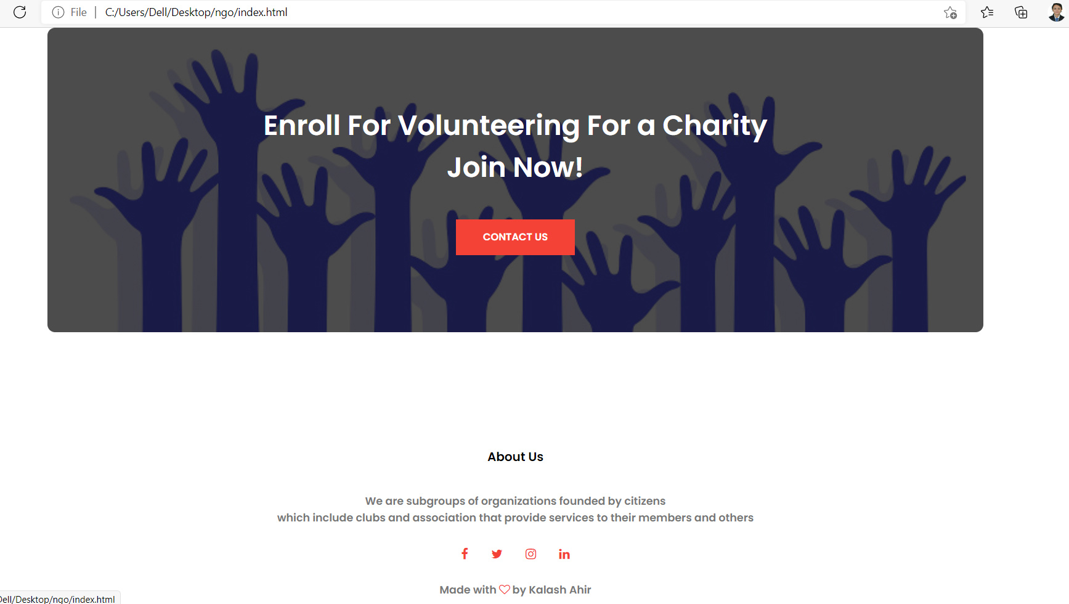
Screen Shots

Slide 16
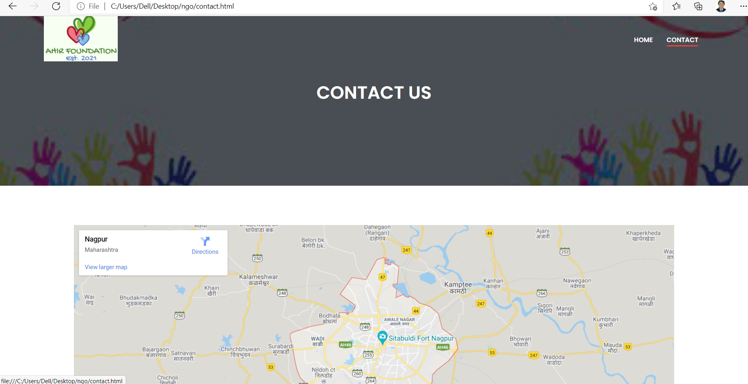
Screen Shots

Slide 17
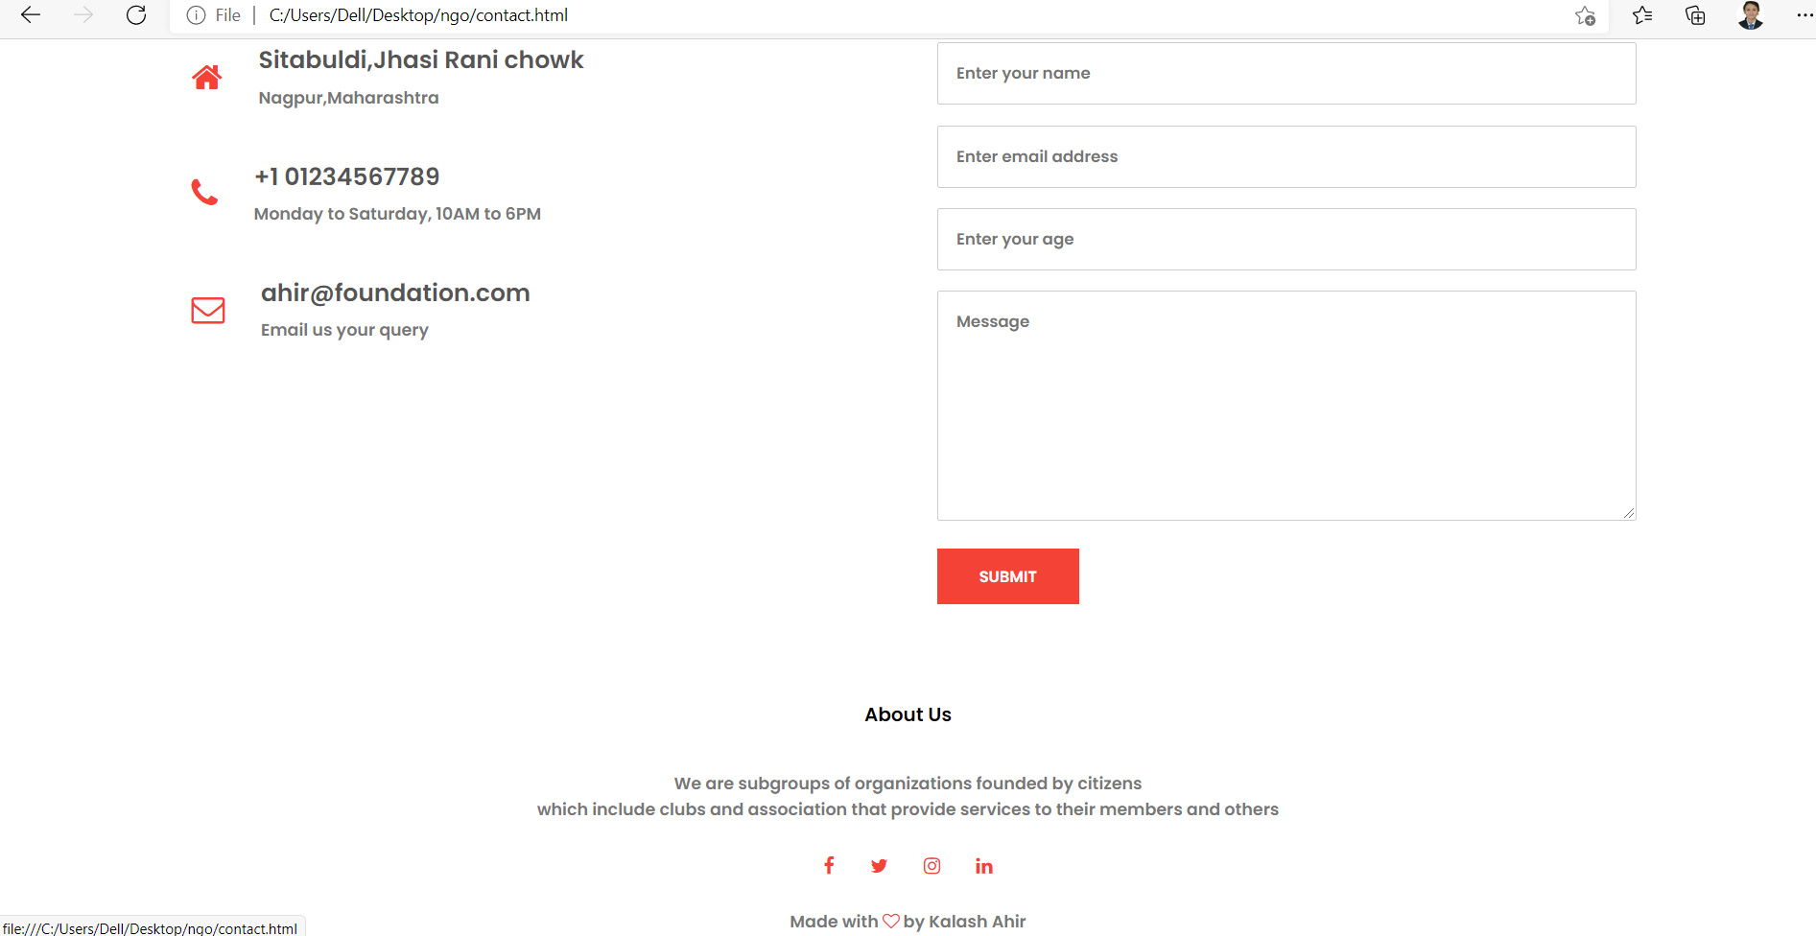
Screen Shots

Slide 18
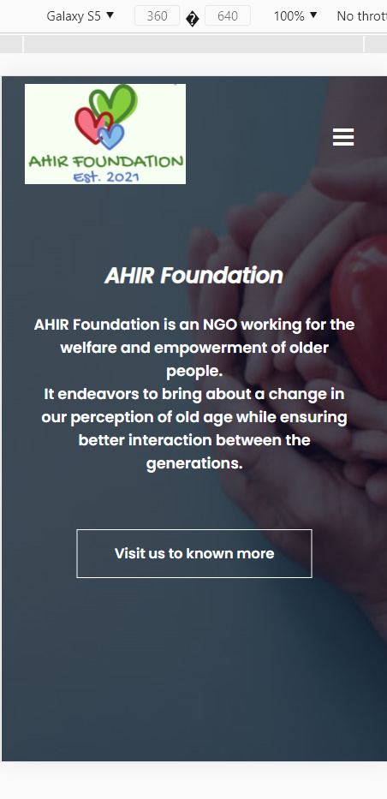
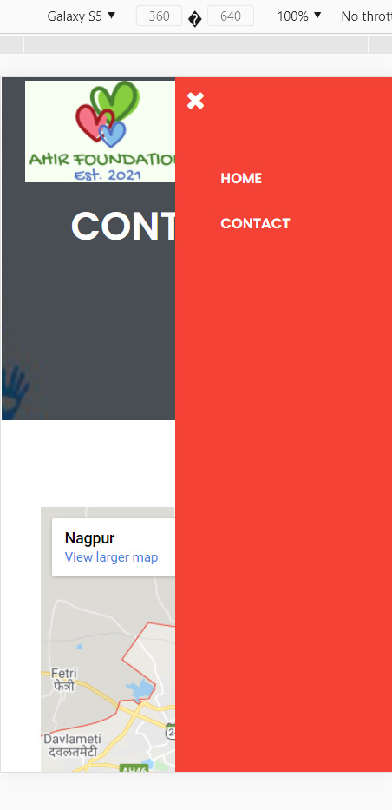
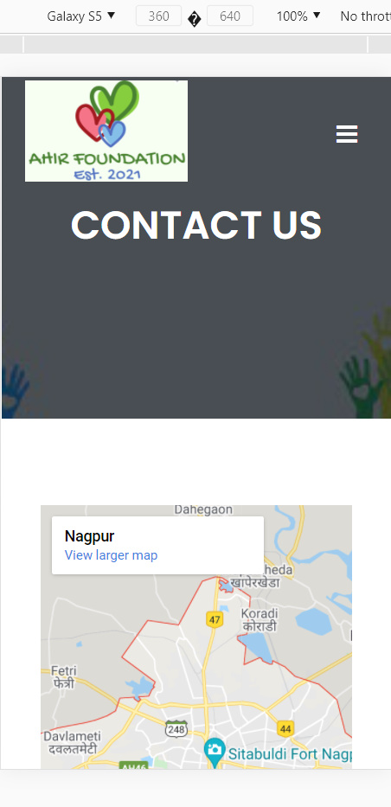
Screen Shots

Slide 19
Technology Used
Front End:
Javascript, CSS, HTML
Back End:-------
IDE:
Sublime Text 3
S. B. Jain Institute of Technology Management and research
19

Slide 20
Hardware Details
List the names of hardware used in your project.
Computer – 8 GB RAM
Monitor
Keyboard
Processor
Memory
Display
S. B. Jain Institute of Technology Management and research
20

Slide 21
Advantages & Applications
Application :
1. Legitimacy: Show You Are Real. A website helps your organization look more professional in the eyes of your donors and partners.
2.Exposure: Share Your Cause With World. Websites are the best tool out there for communication.
3.Contribution: More Helping Hands. ...
4.24×7: Your Doors Are Always Open. ...
5.Eco-Friendly: Save Trees.
Advantages :
Investing time and money into a website is a simple decision for non-governmental organizations (NGOs) around the globe.
An effectively-designed NGO website is great for collecting donations, engaging supporters, and increasing awareness for any cause.
S. B. Jain Institute of Technology Management and research
21

Slide 22
Conclusion
We have entirely completed our project, and our proposed system is designed to reduce the time and save the efforts of the faculties from maintaining huge amount of records. NGOs and people's organizations are organized forms which demonstrate people's participation. People's participation implies empowerment. Empowerment means making people aware of their situation and helping them to address their own problems. It is a process of achieving greater political, social and economic rights.
To promote effective people's participation and participatory development, NGOs are able to provide structures and mechanisms for the involvement of people. Because of their access to grassroots community groups, they are in touch with local realities .During the development of the project we understood the importance of individual while project development and management. While presenting in various seminar we have enhanced our communication skills and displayed professional ethics which will result in lifelong ethics.
S. B. Jain Institute of Technology Management and research
22

Slide 23
Future Scope
In future, NGOs will need to find better ways of building constituencies for their work at every level; methods of working together through strategic partnerships that link local and global processes together; and a much more effective method of identifying barriers to change and points of leverage where their combined ...
S. B. Jain Institute of Technology Management and research
23

Slide 24
Thank You

